Slide 1












A
C
B
Integration, API and MuleSoft
E
D
Modern Approaches to System Integration
In-depth Discussion of Integration Patterns, API Architecture, and MuleSoft Platform
November 1, 2025

Slide 2







Understanding Integration: The Foundation
What is Integration?
Historical Context
IT integration is the process of combining separate software, hardware, and data systems into a single, cohesive unit that can share information and function together seamlessly.
Early systems: Before modern integration methods, companies operated with disconnected systems. A lack of interoperability meant data had to be manually re-entered between applications, which was time-consuming and prone to errors.
Electronic Data Interchange (EDI): The first major step was EDI in the 1970s, which allowed different systems to exchange real-time data messages electronically, signaling the recognition of data communication's importance for businesses.
Rise of APIs and middleware: As the internet and cloud computing grew, more sophisticated integration became possible. Technologies like APIs (Application Programming Interfaces) and middleware became crucial for creating "bridges" that allowed applications to communicate and share data effectively.
Core Concepts
System Integration: Connects software and hardware modules to function as a single, unified infrastructure.
Application Integration: Focuses on connecting separate software applications to allow them to communicate and share data, often through their APIs.
Data Integration: Involves combining data from multiple sources to create a single, unified, and reliable dataset for analysis and reporting.

Slide 3
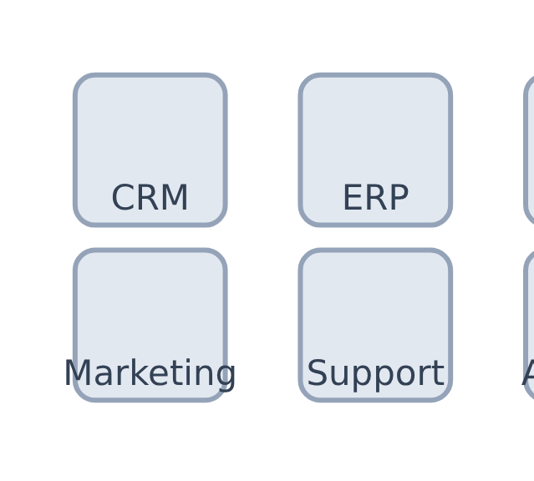
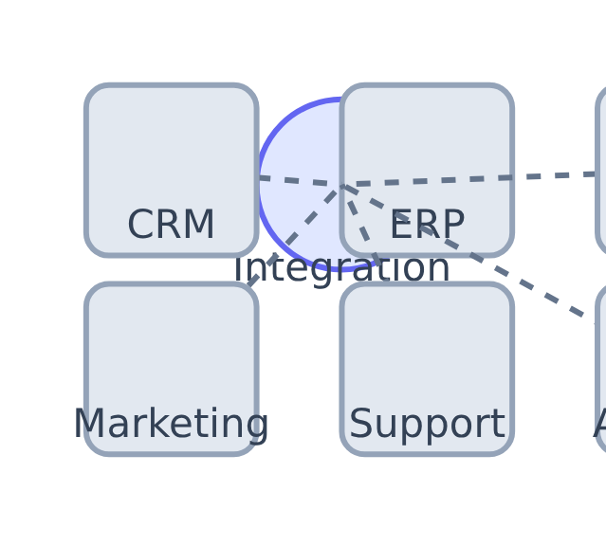





Understanding System Integration:
What is System Integration?
Integration Visualization
System integration is the process of connecting disparate IT systems, applications, and data sources within an organization to enable them to function as a unified whole.
Before Integration
After Integration
Why It Matters
Enables seamless data flow across systems
Disconnected Silos
Connected Systems
Provides unified view of business operations
Supports real-time decision making
Key Insight: Integration is not merely a technical task but a strategic imperative for businesses seeking to optimize operations, enhance decision-making, and deliver seamless customer experiences.
Enhances operational efficiency

Slide 4




















Business Drivers for Integration
The digital landscape has evolved to make system integration a fundamental requirement for modern businesses. Several key business motivations drive the imperative for integration:
Improving Operational Efficiency
Enhancing Customer Experience
Enabling Data-Driven Decisions
Streamlining workflows and automating processes across systems reduces manual effort, minimizes errors, and accelerates business operations.
Integrating customer-facing systems provides a unified view of the customer, enabling personalized interactions and seamless service delivery.
Consolidating data from various sources allows for comprehensive insights, supporting more informed and strategic decision-making.
Accelerating Digital Transformation
Optimizing Supply Chain Management
Key Insight
Effective integration transforms isolated systems into a cohesive digital ecosystem, enabling organizations to respond quickly to market changes and customer needs.
Integration is a cornerstone of digital transformation initiatives, facilitating the adoption of new technologies and enabling agile responses to market changes.
Connecting systems across the supply chain improves visibility, coordination, and responsiveness across inventory, logistics, and procurement.
Integration is not merely a technical task but a strategic imperative for organizations seeking to optimize operations, enhance customer experiences, and enable data-driven decision-making.

Slide 5






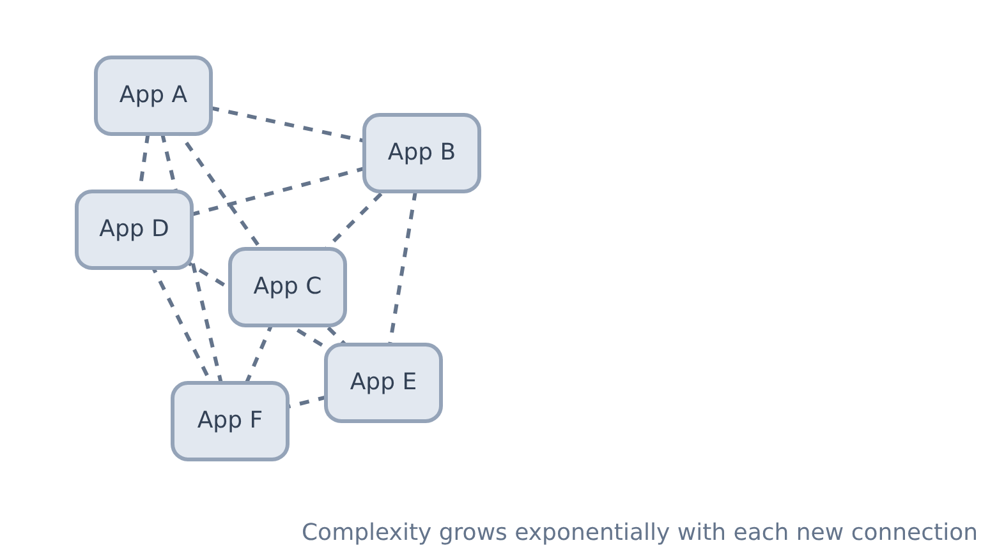









Traditional Integration Challenges
Point-to-Point "Spaghetti Architecture"
Data Silos
Information trapped in isolated databases prevents a holistic view of business operations and customer interactions.
Legacy Systems
Older, often proprietary systems critical to core business functions are difficult to integrate with modern technologies.
Diverse Application Portfolios
Organizations use applications from different vendors with varying data formats, protocols, and APIs.
Key Issue: Each new connection requires custom development, increasing complexity, development time, and potential for errors.
Security and Compliance
Integrating systems requires robust security measures and adherence to various regulatory compliance standards.

Slide 6







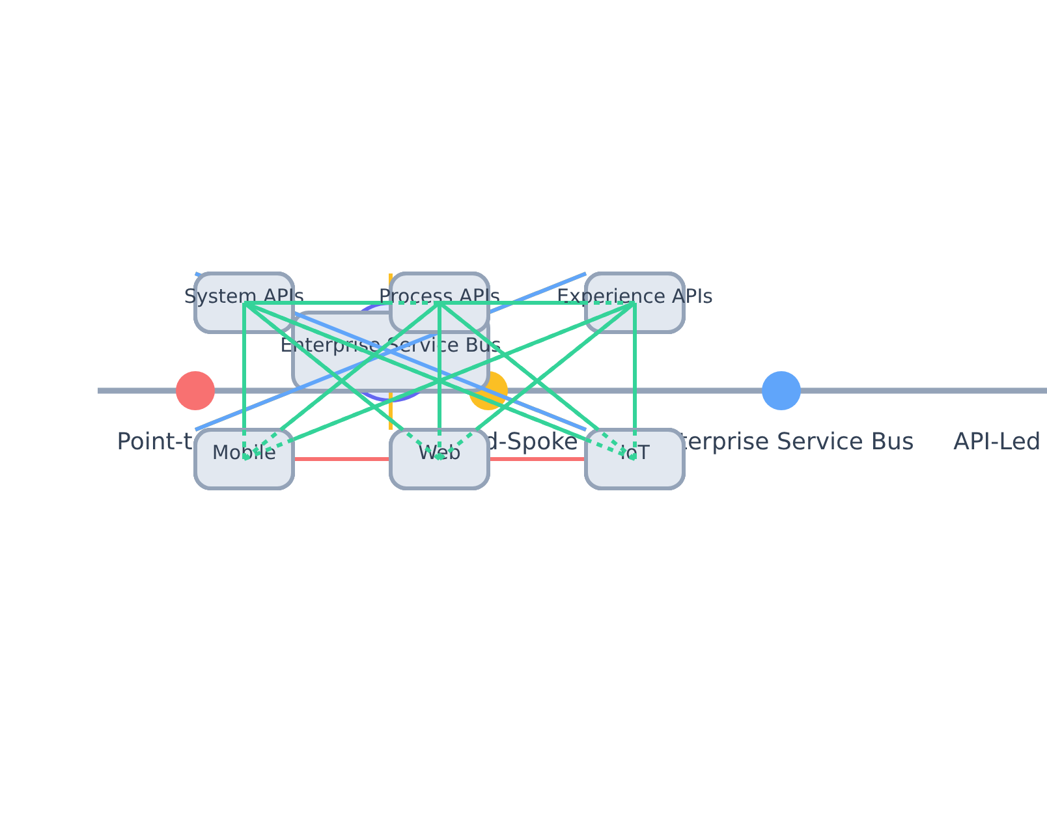









Evolution of Integration Approaches
Integration Patterns Evolution
Point-to-Point
Hub-and-Spoke
Direct connections between applications
Central hub connects to all spokes
Complexity grows with systems
Simpler management than point-to-point
Custom development per connection
Centralized control and visibility
Enterprise Service Bus
API-Led Connectivity
Sophisticated middleware layer
Three-layer API approach
Message transformation, routing
System, Process, Experience APIs
Decouples applications completely
Reusability, agility, scalability

Slide 7





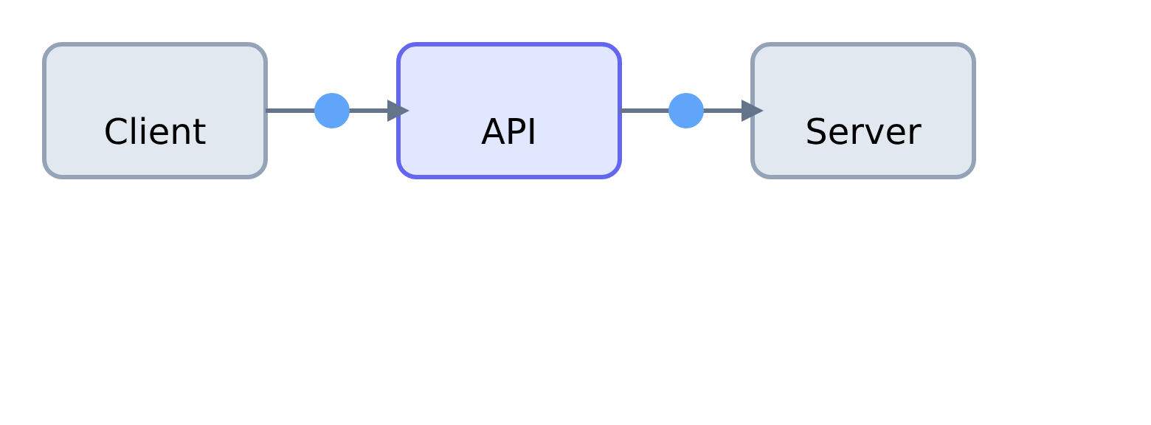












Introduction to APIs: The Modern Approach
What is an API?
How APIs Work
An Application Programming Interface (API) acts as an intermediary that allows two applications to talk to each other. It defines a set of rules and protocols for building and interacting with software applications.
Think of an API as a waiter in a restaurant. The customer (client) places an order with the waiter (API), who then communicates that order to the kitchen (server). The kitchen prepares the food and gives it back to the waiter, who then delivers it to the customer.
Benefits of APIs
Security
Efficiency
Controlled access to system functionalities
Streamlined data exchange between systems
APIs as Building Blocks
Standardized contracts enabling different applications to communicate
Interoperability
Innovation
Enables different systems to work together
Facilitates rapid development of new applications
Abstract away the underlying complexity of systems
Foster the "API economy" where businesses combine functionalities from various sources

Slide 8



















API Types and Standards
REST
SOAP
Representational State Transfer
Simple Object Access Protocol
A widely adopted architectural style for designing networked applications. RESTful APIs are stateless, meaning each request from a client to a server contains all the information needed to understand the request.
A protocol for exchanging structured information in the implementation of web services. SOAP relies on XML for its message format and often operates over HTTP, but can also use other protocols like SMTP or TCP.
Key Characteristics
Key Characteristics
Stateless
XML-based
Each request contains all necessary information
Structured message format with envelope, header, and body
Cacheable
Formal Standards
Responses can be cached for better performance
Built-in security and transaction support
Uniform Interface
Protocol Flexibility
Uses standard HTTP methods: GET, POST, PUT, DELETE
Can operate over multiple protocols (HTTP, SMTP, TCP)
Use Cases
Use Cases
Web services and mobile applications
Enterprise applications with complex transactions
Public APIs and developer ecosystems
Financial and healthcare services
Resource-based operations
Services requiring high security and reliability
REST vs. SOAP Comparison
Feature
REST
SOAP
Architecture
Architectural style
Formal protocol
Message Format
Various (JSON, XML, HTML)
XML only
State Management
Stateless
Stateful

Slide 9








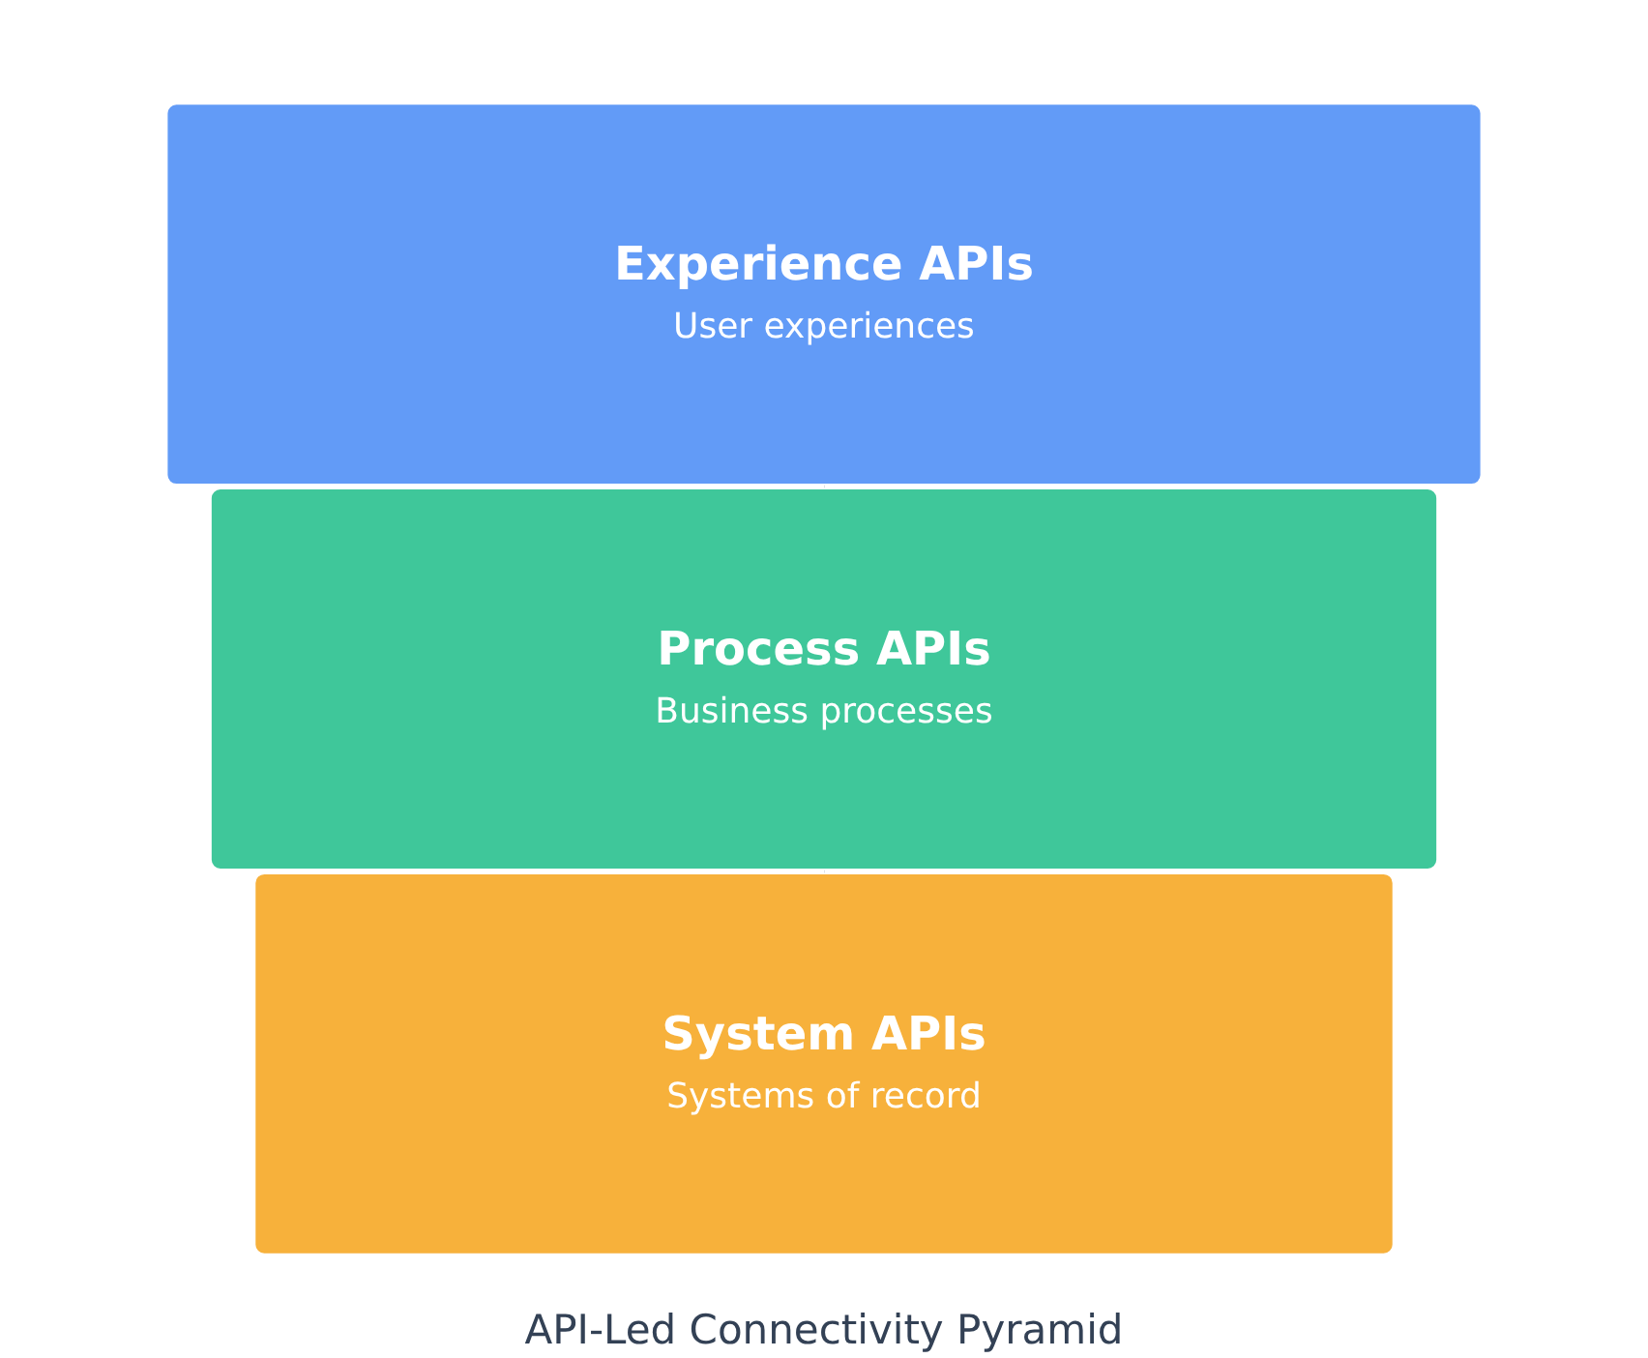








API-Led Connectivity Pattern
Three-Layered Approach
Experience APIs
API-led connectivity organizes APIs into three distinct layers, creating reusable and discoverable integration assets.
Designed for specific user experiences or channels (mobile apps, web portals). They consume Process APIs and tailor data for optimal presentation.
Process APIs
Orchestrate data and logic from multiple System APIs to support specific business processes. They create reusable services for various applications.
System APIs
Provide interfaces to core systems of record (ERP, CRM, databases), abstracting their complexity and exposing data in a standardized way.
Benefits
Reusability
Agility
Scalability
Innovation

Slide 10




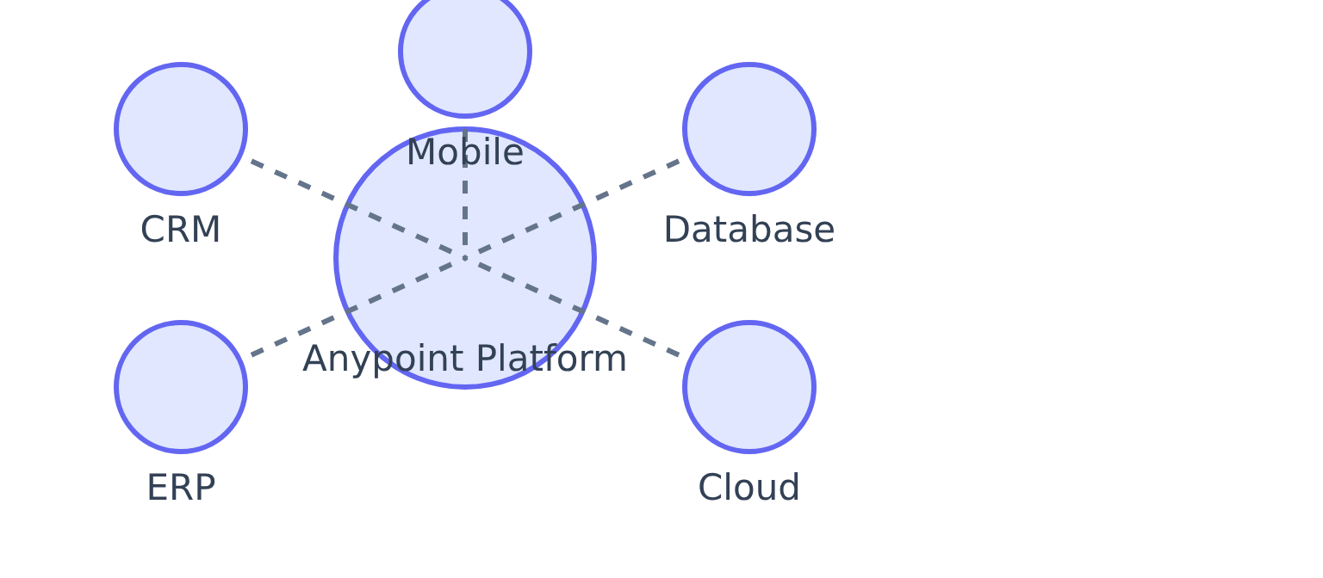









MuleSoft: Platform Overview
MuleSoft Anypoint Platform
Platform Capabilities
A unified, single solution that enables organizations to design, build, deploy, manage, and govern APIs and integrations across various environments.
Key Benefits
Creates an "application network" where applications, data, and devices are interconnected
Moves beyond traditional point-to-point integration
Design & Build
Deploy & Manage
Provides a scalable and resilient approach to digital transformation
Tools for designing, building, and testing APIs and integrations
Deploy applications across various environments with ease
Enables faster innovation and greater agility
Connect
Govern
Pre-built connectors to various applications and systems
Management and security governance for APIs and integrations

Slide 11



















Key Components of MuleSoft
The Anypoint Platform comprises several key components that work together to support API-led connectivity:
Anypoint Design Center
Anypoint Exchange
Mule Runtime Engine
Tools for designing APIs and integrations. Includes API Designer and Flow Designer.
Central hub for discovering, sharing, and managing API assets and connectors.
Lightweight, Java-based runtime that executes API implementations and integration apps.
Anypoint Management Center
Anypoint Connectors
Integration Flow
Pre-built connectors to various applications, databases, and protocols.
Visual representation of how components work together in the MuleSoft platform.
Web-based interface for monitoring and governing APIs and integration apps.
Key Benefits
Reduced development time
Enhanced agility
Improved connectivity
Standardized integration

